Slide 1
Consolidated Clinical Document Architecture(C-CDA)
SAT5131 2024
Kavya Pachchava, Sesha Sai Ramineni, Karunakar Uppalapati, Andrea Wroblewski

Slide 2
What is C-CDA?: Understanding CDA
Clinical Document Architecture (CDA) was developed by Health Level Seven (HL7) International.
CDA is a standard to provide “a common architecture, coding, semantic framework, and markup language for the creation of electronic clinical documents” [2]
CDA documents are coded in Extensible Markup Language (XML).
CDA Documents are Machine Interpretable and Human Readable.
Notes:
To understand what C-CDA is you have to understand CDA first.
What is HL7:
Health Level Seven International (HL7) is a not-for-profit standards-developing organization.
[2]

Slide 3

What is C-CDA?: Understanding CDA
CDA provides a framework with basic components for storing healthcare data. These components can be used to collect, save, access, show, and send electronic health information in various formats. These standardized components can be organized in different ways to suit different purposes or requirements.
or
Notes:
They are essentially building blocks.
[2]

Slide 4
Understanding CDA: Principal Characteristics
CDA Defines a Clinical Document to Have 6 Characteristics:
Persistence: The document must exist in an unchanged state for a period of time defined by regulatory requirements
Stewardship: It must be maintained by the organization entrusted with its care
Potential for authentication: It must be able to be legally authenticated
Context: It establishes the context for the information contained in the document
Wholeness: The authentication of the document applies to the whole document
Human readability: It is human-readable
Notes:
[1]

Slide 5
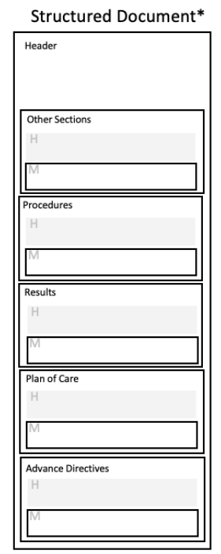
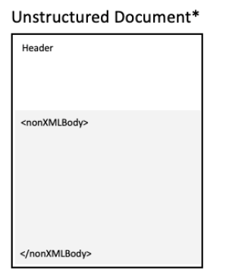
Understanding CDA: Structured Vs. Unstructured
Notes:
A CDA Document can be Structured or Unstructured.
Every CDA document must include a structured header
Structured: A Structured header with a structured body
Unstructured: A structured header with a nonXMLBody Element.
[1]

Slide 6
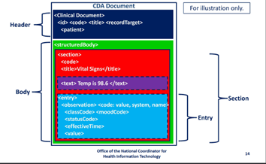
CDA Structured Document
Header: Describes the scope and Intended use. It includes who created the document, patient information, and encounter information. It sets the context for the document.
Body: is made up of sections
Section: This is made up of entries. It can contain zero, one, or multiple entries. Section templates can be used by more than one document template.
Entry: A specific piece of information or clinical statement, such as a specific medication or procedure.
Notes:
Section: Section templates are defined globally and may be used by more than one document template. For example, the template defining the Medications section are used in both a CCD and Referral Note. [1] & [2]

Slide 7
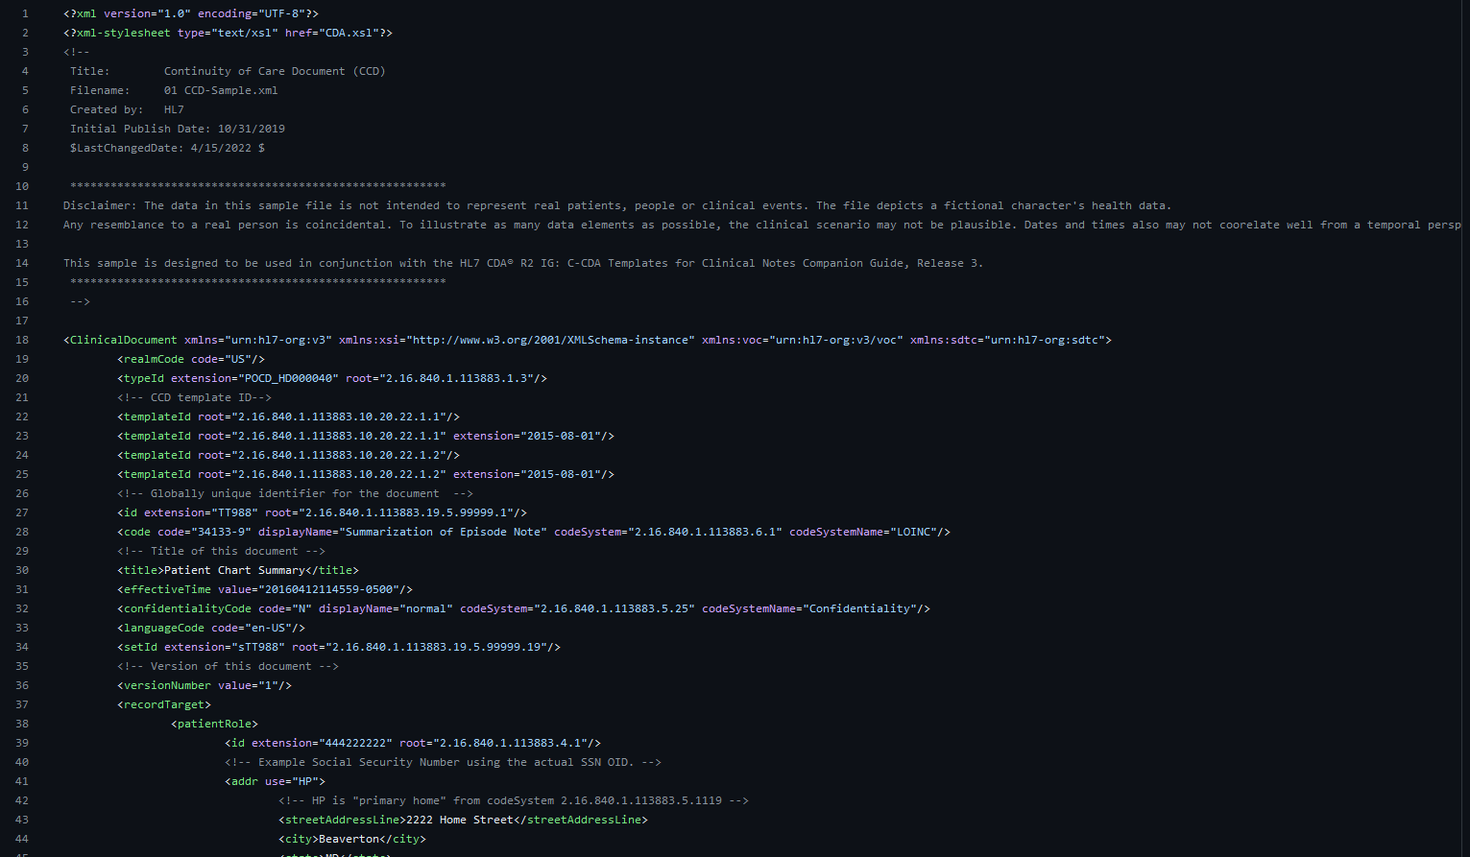
Understanding CDA
XML Code Example
Notes:
Code Sample in XML-
Full code is 2731 lines
[4]

Slide 8
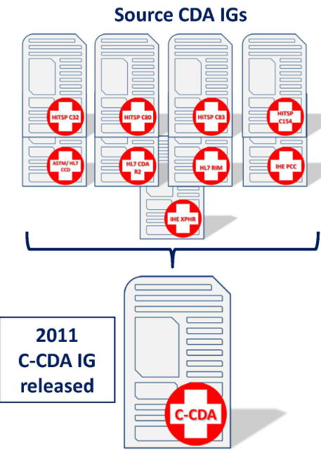
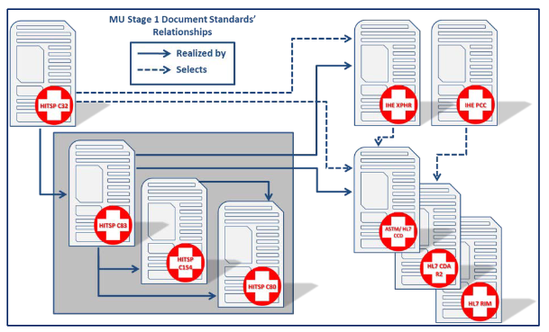
What is C-CDA?
Pre-Consolidation:
Consolidation:
Notes:
Different Standard Development organizations were developing different CDA Implementation Guidelines(IG). Basically, there were different approaches for document template requirements being created, which jeopardized interoperability. The Office of the National Coordinator for Health Information Technology (ONC) worked with these different standard development organizations to address this issue. They consolidated these multiple different IGs into a new single IG. Thus creating the C-CDA [2]

Slide 9
What is C-CDA?
Consolidated Clinical Document Architecture.
C-CDA is a specific implementation of the CDA standard focused on consolidating various clinical documents into a standardized format for exchange and interoperability.
C-CDA is an implementation guide(IG) on building the most common CDA Documents for exchange purposes.
C-CDA was introduced as part of the Health Information Technology for Economic and Clinical Health (HITECH) Act’s Meaningful Use requirements.
Notes:
C-CDA is a set of templates of directed instruction on particular documents, How to put them together, and implement them on CDA standards.
What is MU? To qualify for incentive payments through the Centers for Medicare & Medicaid Services EHR Incentive Programs, eligible providers and hospitals must demonstrate meaningful use of an electronic health record (EHR). In other words, “meaningful use” sets the specific objectives that eligible professionals and hospitals must achieve to participate in the EHR Incentive Programs. [5]
[1] & [2]

Slide 10
What is C-CDA?
Document Types:
Care Plan
Consultation Note
Continuity Of Care Document
Diagnostic Imaging Report
Discharge Summary
History and Physical
Operative Note
Progress Note
Procedure Note
Referral Note
Transfer Summary
Unstructured Document
Notes:
These are the documents included in the CCDA IG.
We will use the Continuity of Care Document (CCD) as an example.
[1]

Slide 11
What is C-CDA? The CCD
According to the C-CDA IG “The Continuity of Care Document (CCD) represents a core data set of the most relevant administrative, demographic, and clinical information facts about a patient's healthcare, covering one or more healthcare encounters. It provides a means for one healthcare practitioner, system, or setting to aggregate all of the pertinent data about a patient and forward it to another to support the continuity of care.”[1]
Notes:
We will look at a CCD as an example. What is a CCD?

Slide 12
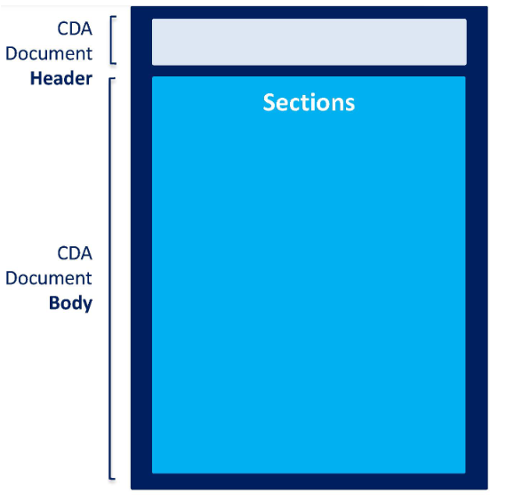
C-CDA Document Example: Continuity Of Care Document (CCD)
**These are the sections required by the CCD Template in the C-CDA Implementation Guidelines:
US Realm Header
There also are some sections that require vocabulary that must be used.
Allergies and Intolerances**
Medications Section**
Problem Section**
Results Section**
Social History Section**
Vital Signs Section**
No single C-CDA document template contains all the data requirements to sufficiently meet MU2 compliance.
Notes:
The US Realm General Header is used for documents that are authored by clinicians and systems supporting clinicians, and the US Realm Patient Generated Header is used for documents that are authored by patients and systems supporting patients. The CDA Header sets the context for the entire document. [1]
Sections are required for a Document Template when the information contained in those sections will ALWAYS BE clinically relevant to the clinical scenario the document template is intended to describe.
You will also have to add sections to meet meaningful use requirements: C-CDA & MU2 guidelines must be implemented together.
[1] & [2}

Slide 13
C-CDA Document Example: Continuity Of Care Document (CCD)
These are the optional sections outlined by the CCD Template in the C-CDA Implementation Guidelines:
Procedures Section
Encounters Section
Family History Section
Functional Status Section
Immunizations Section
Medical Equipment Section
Payers Section (
Plan of Treatment Section
Mental Status Section
Nutrition Section
Advance Directives Section
Goals Section
Health Concerns Section
Notes:
[1]

Slide 14
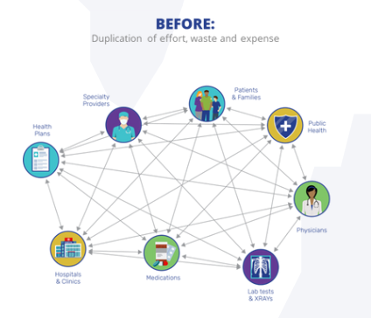

How is C-CDA Transmitted? HIE
The C-CDA IG does not dictate how documents are transmitted.
Electronic health information exchange (HIE) allows healthcare providers to access information electronically.
Three forms of HIE:
Directed Exchange: Providers can securely send patient information directly to another healthcare professional.
Query-based Exchange: Providers search accessible clinical sources on a patient, often used in unplanned care.
Consumer Mediated Exchange: Patients control their own health information.
Notes:
The actual transmission methods and protocols for C-CDA documents can vary depending on the systems involved. Common methods for transmitting C-CDA documents include:
Michigan Health Information Network Shared Services (MiHIN).
[3]& [6]:

Slide 15
C-CDA In the Healthcare Setting
Example:
A patient comes into the ED via EMS.
The patient is an 80 y.o. female was found on the floor of her home by a neighbor.
The patient is found confused, lethargic, and has nobody with her.
Minimal information about the patient besides name and DOB is known
We look the patient’s name in the EHR, and we were in luck: the patient visited their PCP recently, and they completed a Continuity Of Care Document (CCD) in preparation for an upcoming hip replacement!
Notes:
We use a Query-based Exchange

Slide 16
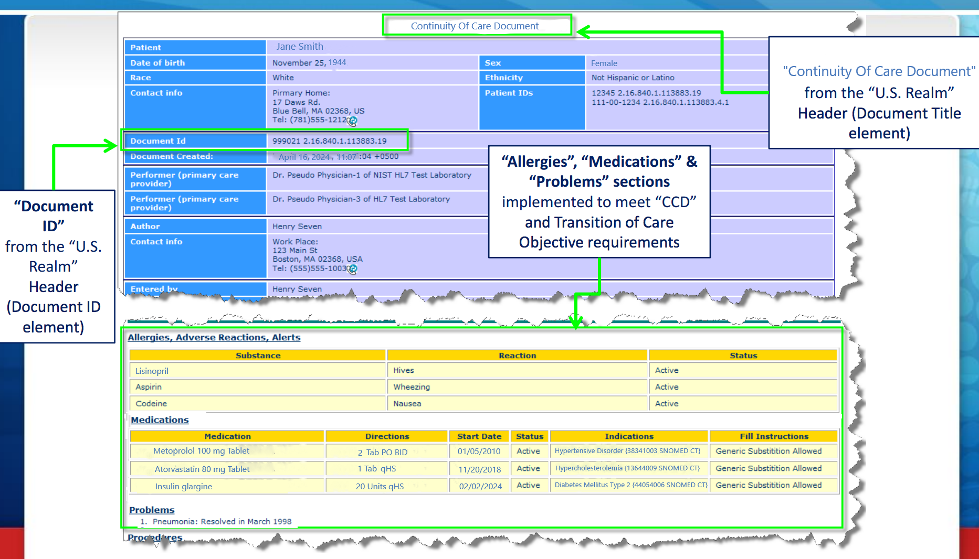
CCD Example
Notes:
This is what we might see when looking at the CCD
Since the patient is confused, she is unable to provide any information. Now, thanks to the CCD and C-CDA, we can see the patient’s history and allergies.
Now we know that the patient has a history Of Diabetes, High Cholesterol, and Hypertension.
We also can see the patient has a history of stroke but is normally A & O x4. We did imaging and found she had a stroke.
We must transfer a patient to a Stroke Hospital.
Now the provider can create a transfer summary.

Slide 17

Transfer Summary
Required Sections:
Allergies and Intolerances Section
Medications Section
Problem Section
Results Section
Vital Signs Section
Reason for Referral Section
Optional Sections:
Physical Exam Section
Encounters Section
Family History Section
Functional Status Section
Discharge Diagnosis Section
Immunizations Section
Medical Equipment Section
Payers Section
Plan of Treatment Section
Procedures Section
Social History Section
Mental Status Section
General Status Section
Review of Systems Section
Nutrition Section
Past Medical History
History of Present Illness Section
Assessment and Plan Section
Assessment Section
Admission Medications Section
Admission Diagnosis Section
Course of Care Section
Advance Directives Section
Notes:
According to the CCDA IG a transfer summary includes:
Ms. Smith is being transferred to the new hospital and prior to her arrival the staff is able to look up the history and what they already did previously to save time because time is brain!
[1]

Slide 18
Operative Note
Required Sections:
Anesthesia Section
Complications Section
Preoperative Diagnosis Section
Procedure Estimated Blood Loss Section
Procedure Findings Section
Procedure Specimens Taken Section
Procedure Description Section
Postoperative Diagnosis Section
Optional Sections:
Procedure Implants Section
Operative Note Fluids Section
Operative Note
Surgical Procedure Section
Plan of Treatment Section
Planned Procedure Section
Procedure Disposition Section
Procedure Indications Section
Surgical Drains Section
Notes:
Ms. Smith is at the Stroke hospital, and they have done a Carotid endarterectomy. Now once the surgeon is done, they can write an operative note.
Now, the patient comes into the recovery room, and the patient is still confused. The OR staff want to give a quick report and run off because they have another emergency case. Luckily for the recovery nurse, they read the CCD, Transfer Summary, and operative note and found out about the patient prior to their arrival to the PACU. Thanks C-CDA!
[1]

Slide 19
C-CDA In the Healthcare Setting: Stakeholders
Nurses
Doctors
Other Healthcare Providers
Health Information Exchanges (HIEs)
Patients and Caregivers
Regulatory Bodies

Slide 20
References:
HL7. (2023). HL7 CDA® R2 Implementation Guide: C-CDA Templates for Clinical Notes STU Companion Guide, Release 4.1 (US Realm), Standard for Trial Use, June 2023, Specification Version 4.1.1. https://www.hl7.org/ccdasearch/pdfs/Companion_Guide.pdf
HealthIT.gov. (2013). Implementing Consolidated-Clinical Document Architecture (C-CDA) for Meaningful Use Stage 2. Retrieved from https://www.healthit.gov/sites/default/files/c-cda_and_meaningfulusecertification.pdf
HealthIT.gov. (2020). What is Health Information Exchange (HIE)? Retrieved from https://www.healthit.gov/topic/health-it-and-health-information-exchange-basics/what-hie (Accessed April 20, 2024).
HL7. (2019). Continuity of Care Document (CCD) (01 CCD-Sample.xml). GitHub. https://github.com/HL7/CDA-ccda-companion/blob/master/examples/xml/CCD.xml
HealthIT.gov. (2019). What is Meaningful Use? Retrieved, from https://www.healthit.gov/faq/what-meaningful-use (Accessed: April 22, 2024)
Michigan Health Information Network. (n.d.). Strategic Plan. Retrieved from https://mihin.org/strategicplan/ (Accessed: April 22, 2024)
Medicare and Medicaid Programs; Electronic Health Record Incentive Program – Stage 2. Federal Register, 2012, 77(171), 42 CFR Parts 412, 413, and 495. https://www.govinfo.gov/content/pkg/FR-2012-09-04/pdf/2012-21050.pdf
HealthIT.gov. (2012.). Clinical Document Architecture (CDA), Consolidated-CDA (C-CDA) and their Role in Meaningful Use (MU). Retrieved from https://www.healthit.gov/sites/default/files/resources/cda_c-cda_theirrole_in_mu.pdf
Notes:
.

